Slide 1

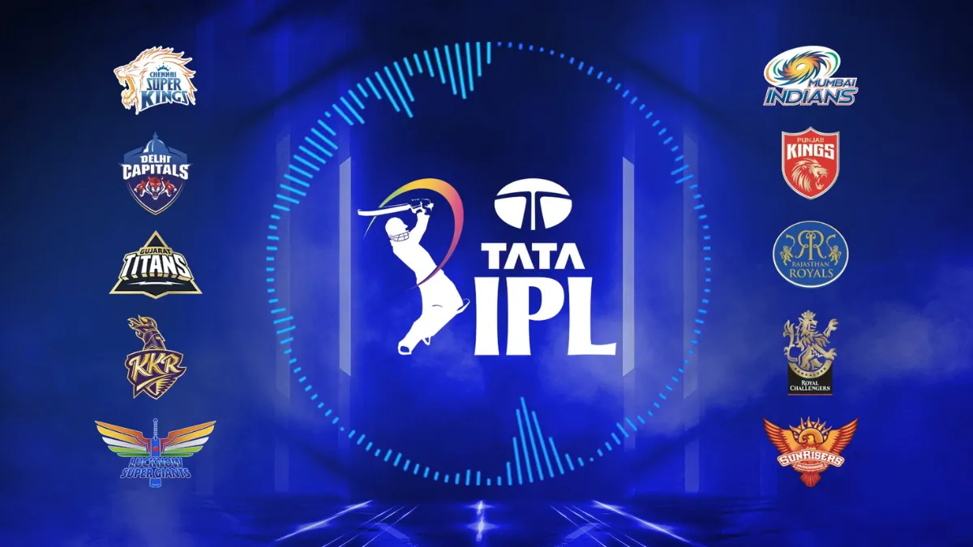

IPL ANALYSIS : Unveiling the Story of IPL
(2021-2023)

Slide 2
PROBLEM STATEMENT
"Sports Basics" is a sports blog company that entered space recently. They wanted to get more traffic to their website by releasing a special edition magazine on IPL 2024.
This magazine aims to provide interesting insights and facts for fans, analysts and teams based on the last 3 years' data.
OBJECTIVE
Unveiling Top Performance of players & Teams
Predicting the results for IPL 2024
Building the Ideal Team

Slide 3
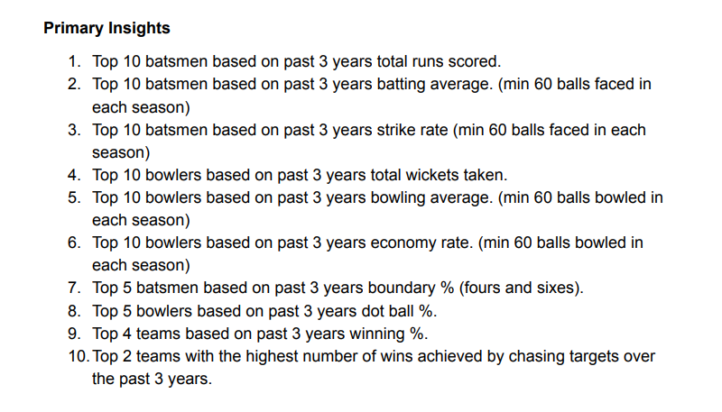
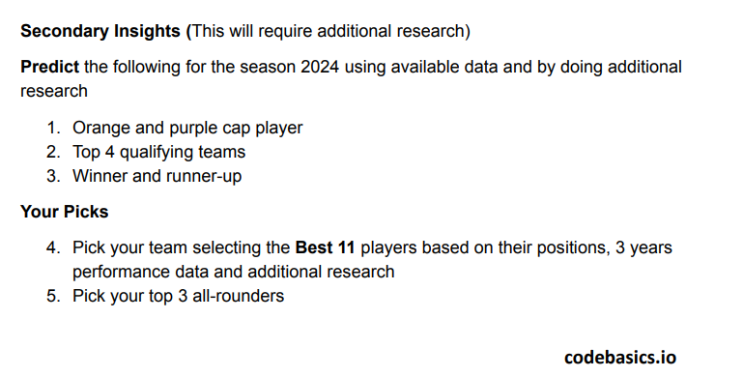

Slide 4
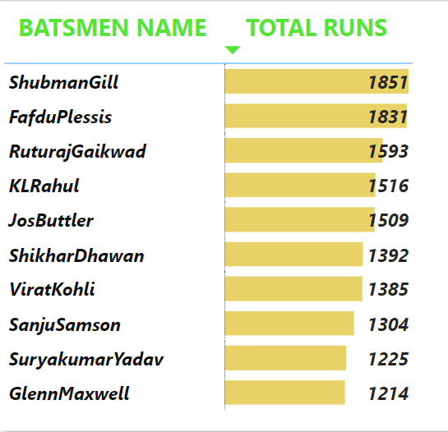

TOP 10 BATSMEN BASED ON PAST 3 YEARS TOTAL RUNS SCORED
7 out of the top 10 batsmen have been Indian players! This highlights the growing prowess of Indian batting talent in the league, showcasing their ability to consistently perform at the highest level.

Slide 5
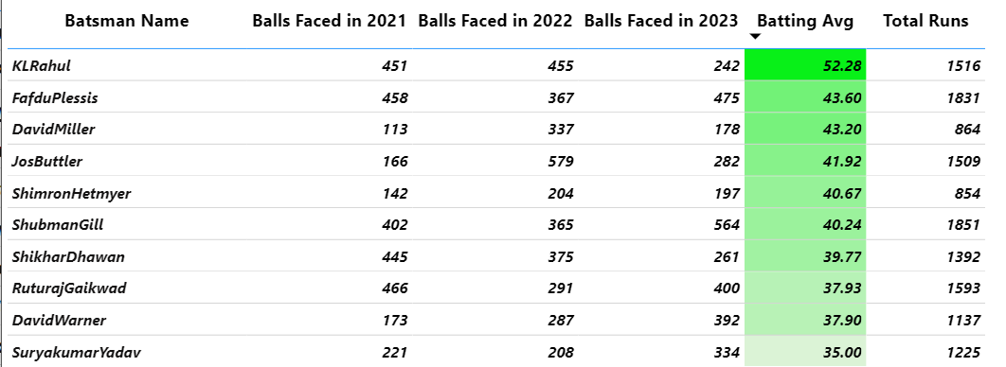
2. Top 10 batsmen based on past 3 years batting average. (min 60 balls faced in each season)
Scoring over 1500 runs with an average above 40 is a truly elite achievement in the high-pressure environment of the IPL,This level of sustained performance from KL Rahul, Faf du Plessis, Jos Buttler, and Shubman Gill over multiple seasons speaks about their exceptional talent and ability to dominate the league.

Slide 6
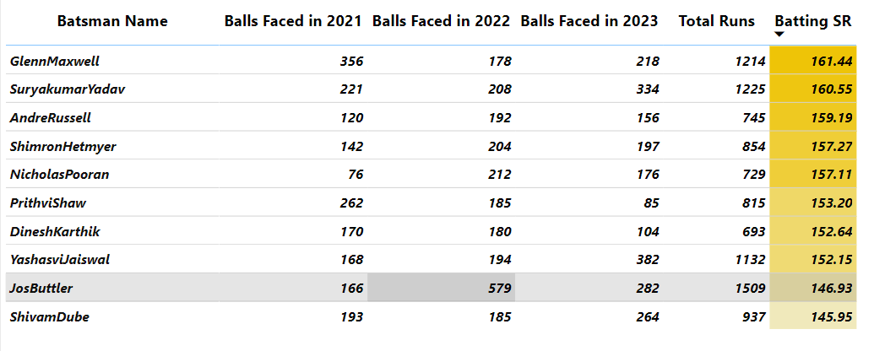
3. Top10 batsmen based on past 3 years strike rate (min 60 balls faced in each season)

Slide 7
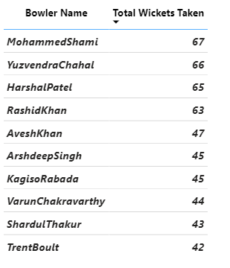
4. Top 10 bowlers based on past 3 years total wickets taken.
These are the players ,who have been consistently displayed exceptional wicket-taking abilities, proving themselves as crucial threats to any batting lineup over the past three years.

Slide 8
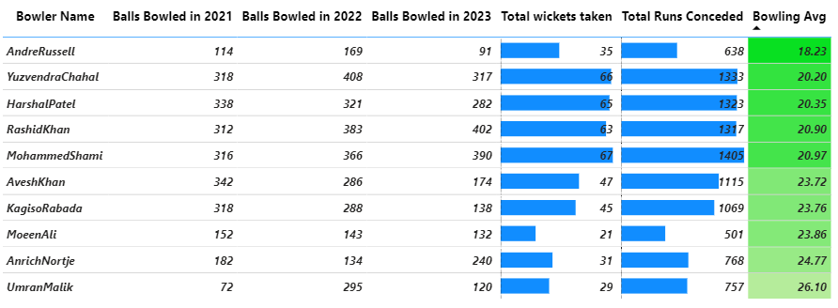
5. Top 10 bowlers based on past 3 years bowling average. (min 60 balls bowled in each season)

Slide 9
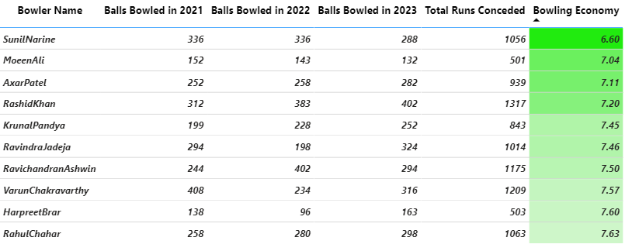
6. Top 10 bowlers based on past 3 years economy rate. (min 60 balls bowled in each season)
Taking wickets is crucial, a bowler's true value is often measured by their economy. These are the bowlers who possess both strong wicket-taking abilities and impressive bowling economy.

Slide 10
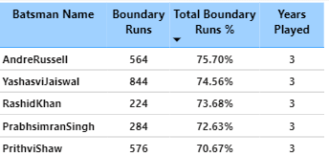
7. Top 5 batsmen based on past 3 years boundary % (fours and
sixes)
Players like Andre Russell, Yashasvi Jaiswal, Rashid Khan, Prabhsimran Simran, and Prithvi Shaw provide the X-factor to the teams, capable of accelerating the innings rapidly and putting immense pressure on the opposition bowling attack

Slide 11
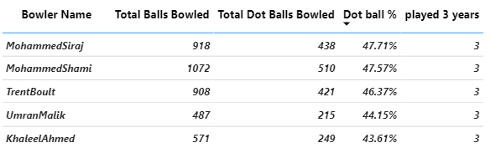
8. Top 5 bowlers based on past 3 years dot ball %.
Mohammed Siraj, Mohammed Shami, Trent Boult, Umran Malik, and Khaleel Ahmed have consistently displayed exceptional control over their bowling, reflected in their high dot ball percentages. This ability to restrict scoring opportunities and create pressure situations makes them invaluable assets, especially in the crucial middle and death overs.

Slide 12
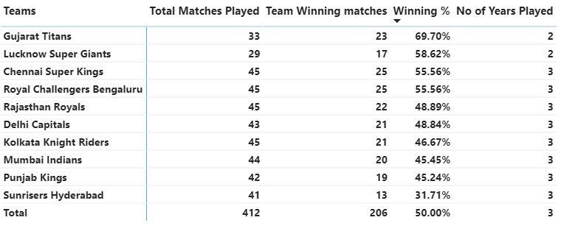
9. Top 4 teams based on past 3 years winning %.
Gujarat Titans, Lucknow Super Giants, Chennai Super Kings, and Royal Challengers Bengaluru have established themselves as an genuine championship contenders. Their consistent success over the past three seasons makes them the teams to watch in the upcoming IPL, as they possess the formula for winning on a regular basis."

Slide 13
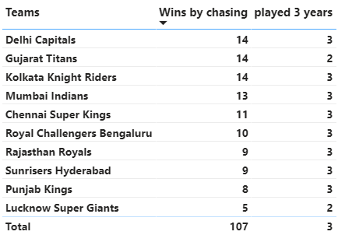
10.Top 2 teams with the highest number of wins achieved by chasing targets over the past 3 years.
Delhi Capitals and Gujarat Titans have emerged as masters of the chase in the IPL. These two teams have consistently secured the most victories while chasing targets, showcasing their exceptional game management, adaptability, and ability to handle pressure situations effectively.

Slide 14
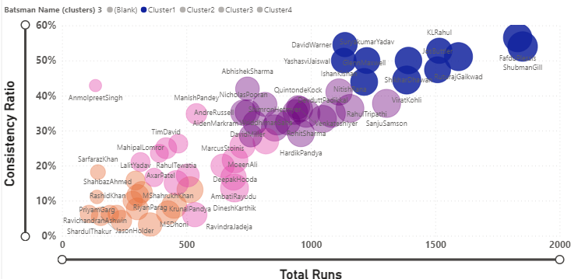
11(a) Predict the Orange cap player for the season 2024 using available data and by doing additional research.
PAST 3 YEARS CONSISTENCY RATIO
CURRENT FORM
CONSISTENT PLAYERS :
FafDuplesis, David Warner, Shubman Gill, Ruturaj Gaikwad, KL Rahul, Shikhar Dhawan, Yashasvi
Jaiswal , Jos Buttler, Virat Kohli,glen Maxwell and Surya Kumar Yadav Maintaining The High
Consistency Ratio From Past 3 Years

Slide 15
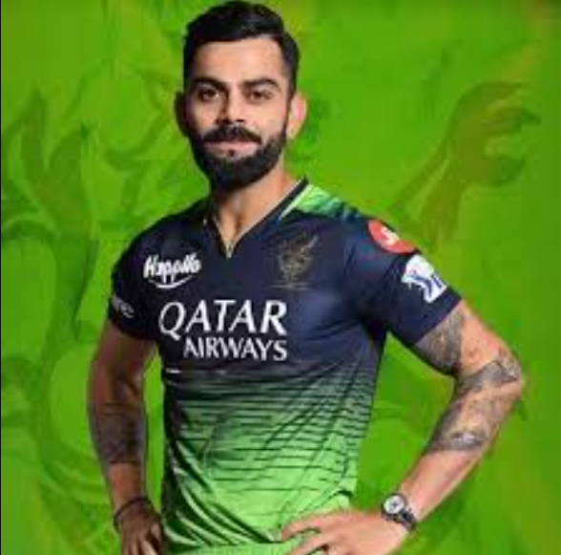
ORANGE CAP PLAYER
Improved Batting Form: Compared to the previous two seasons, Kohli has shown a significant improvement in his batting form. He appears more confident, aggressive, and is timing the ball well.
Mentality and Focus: Kohli's recent return to form and his well-known competitive spirit suggest he is highly motivated to win the Orange Cap.
Strong Batting Position: Batting as an opener allows Kohli to play a significant portion of the innings, maximizing his opportunity to score runs.
Leading Run-Scorer: As of April 29th, 2024, Virat Kohli holds the Orange Cap with a substantial lead, having scored 500 runs in 10 matches. This demonstrates his consistent performance throughout the season.
VIRAT KOHLI

Slide 16
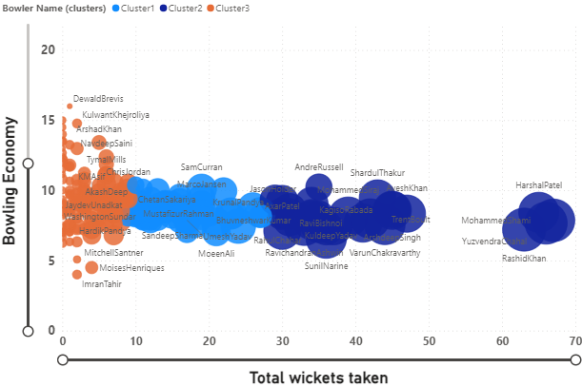
11(b) Predict the purple cap player for the season 2024 using
available data and by doing additional research.
PAST 3 YEARS PERFORMANCE
CURRENT FORM
TOP WICKET-TAKERS
Mohammed Shami, Yuzvendra Chahal, Harshal Patel And Rashid Khan Are The Leading
Wicket-takers Over The Past Three Seasons , Indicating Their Effectiveness And Importance
To Their Respective Teams.

Slide 17
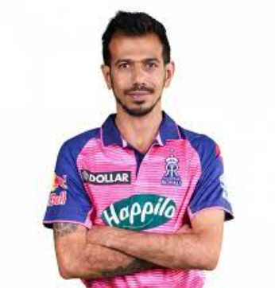
PURPLE CAP PLAYER
Strong Start: Chahal has made a solid start to IPL 2024, consistently taking wickets and currently sitting in the top 5 of the Purple Cap race. He currently holds the record for the fastest bowler to reach 200 IPL wickets,showcasing his consistent performance.
Confidence and Experience: Chahal's recent success and vast experience in the IPL have boosted his confidence, which can translate to even better performances in the remaining matches.
Remaining Matches: With a significant number of matches remaining, Chahal has ample time to climb the leaderboard and potentially overtake the current frontrunners.
YUZVENDRA CHAHAL

Slide 18




12. Predict the Top 4 qualifying teams for the season 2024 using available data and by doing additional research
Their consistent performance over the past three seasons has been impressive, reaching the playoffs once ,current season they are showcasing a strong understanding of the game.
LSG has shown remarkable consistency in their first two ipl season ,which says their competitiveness and Significant potential.
A proven IPL powerhouse, CSK boasts multiple championship titles and a history of reaching the playoffs consistently. Their experience and strategic
prowess make them a constant threat.
KKR has a rich history of playoff appearances and championship wins. currently holding a strong position in the top half of the table.

Slide 19
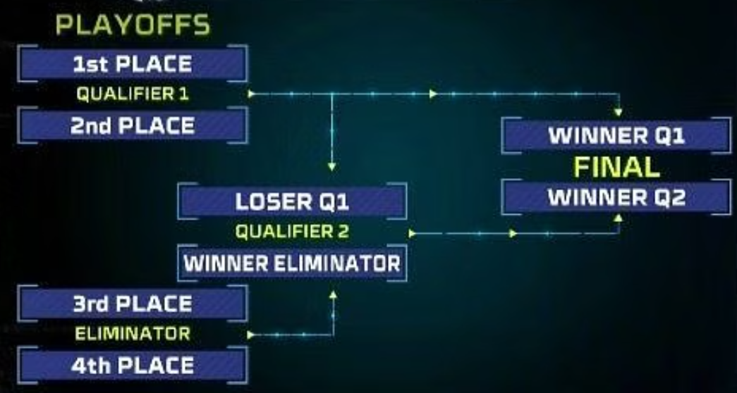




ROADMAP

Slide 20





13. Predict the Winner and runner-up for the season 2024 using available data and by doing additional research

Slide 21
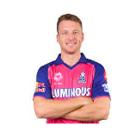
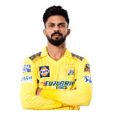

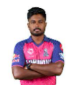
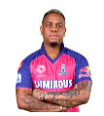

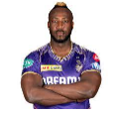
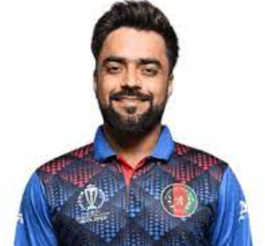


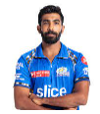
14. Pick your team selecting the Best 11 players based on their positions, 3 years performance data and additional research
JOS BUTTLER
Ruturaj Gaikwad
Shubman Gill
Sanju Samson
Shimron Hetmyer
Dinesh Karthik
Batting SR:-146.35
Batting Avg : 42.30
Batting SR:-137.43
Batting Avg : 37.97
Batting SR:-144.94
Batting Avg : 42.94
Batting SR:-146.38
Batting Avg : 22.44
Batting SR:-173.06
Batting Avg : 55.67
Batting SR:-184.50
Batting Avg : 34.00
Andre Russell
Rashid Khan
Yuzvendra Chahal
TrentBoult
Jasprit Bumrah
Batting SR:-174.00
Batting Avg : 38.67
Batting SR:-160.98
Batting Avg : 18.00
Bowling Avg:-20.20
Economy :7.67
Bowling Avg:-28.81
Economy :8.00
Bowling Avg:-22.03
Economy : 7.32

Slide 22
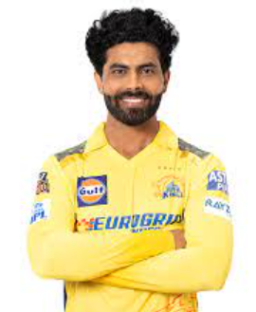
15. Pick your top 3 all-rounders
Andre Russell
Rashid Khan
Ravindra Jadeja
Explosive Batting
Impactful Bowling
World-Class Spinner
Solid Lower-Order Contributor
Balanced All-rounder
Reliable Batsman

Slide 23


Slide 24
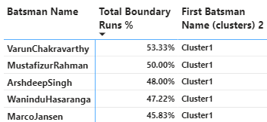
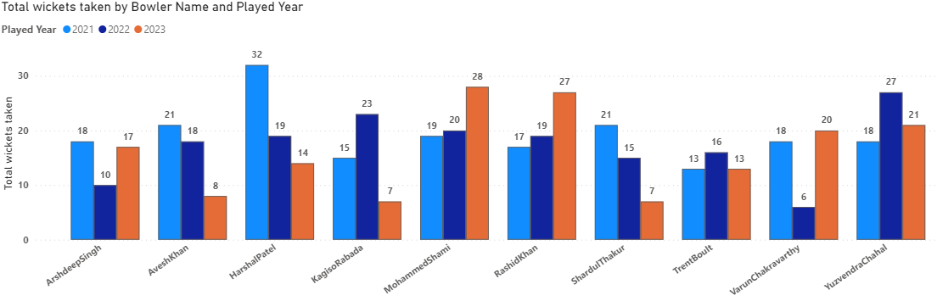
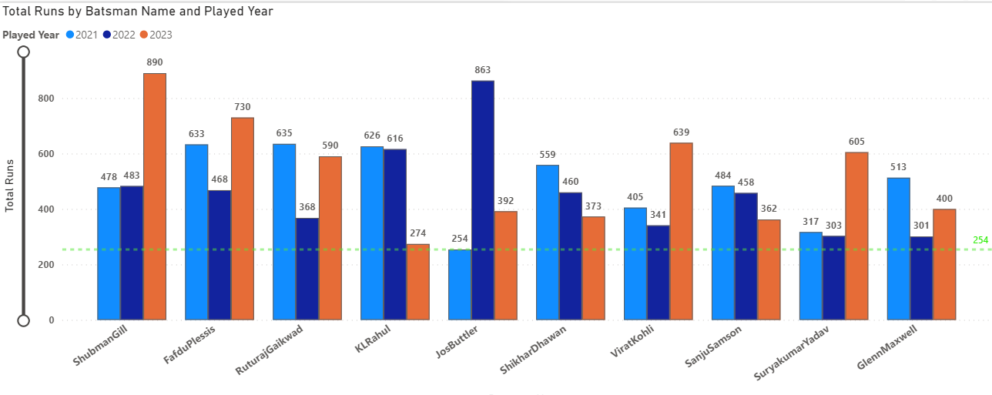

Slide 25
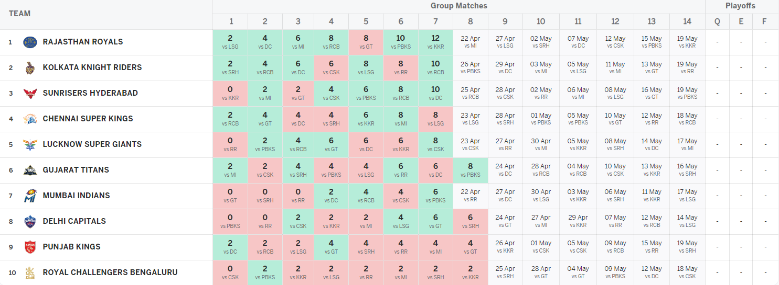

Slide 26
Add an Filter to select an each team
No of Times Won Title
No of times played Finals
No of times entered into play offs
Add head to head Analysis of selected filter team vs all the other teams (Matrix visual )
Table Position from each season BY LINE CHART VISUAL/RIBBON CHART
Boundary % ,total wickets taken & total runs scored from each season plot the graph using line chart / dual axis chart
Pie / donut chart to represent the overall win% and loss % of selected team

Slide 27
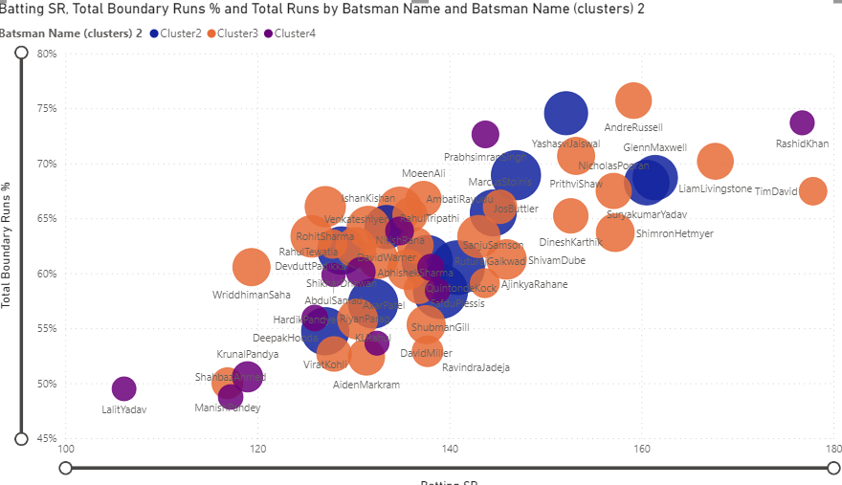
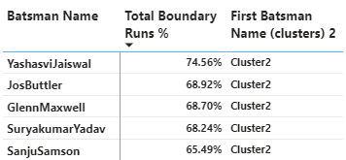
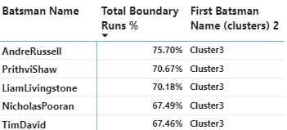
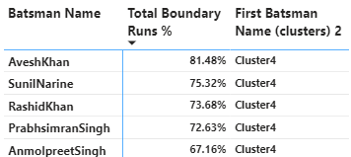
7. Top 5 batsmen based on past 3 years boundary % (fours and sixes).
ANDRE RUSSEL,YASHASVI JAISWAL ,RASHID KHAN, PRABHISIMRAN SIMRAN,PRITHVI SHAW
WERE THE TOP 5 PLAYERS WITH AN GOOD BATTING SR AND HIGHEST BOUNDARY %

